Slide 1
PerfTest: Application Monitoring
Yoonki Song
Last Updated: Oct. 2, 2009

Slide 2
Application Monitoring
Overview

Slide 3
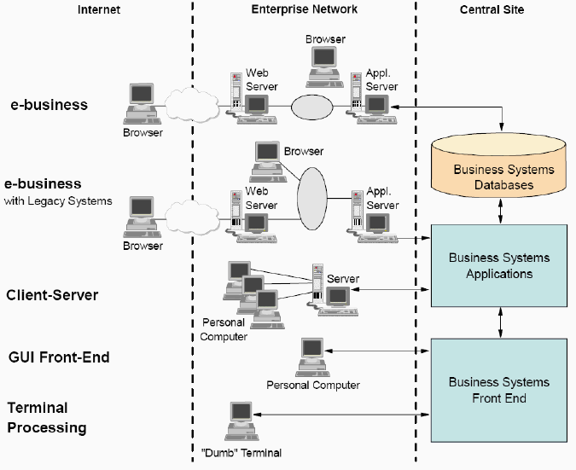
Distributed Environment Complexity

Slide 4
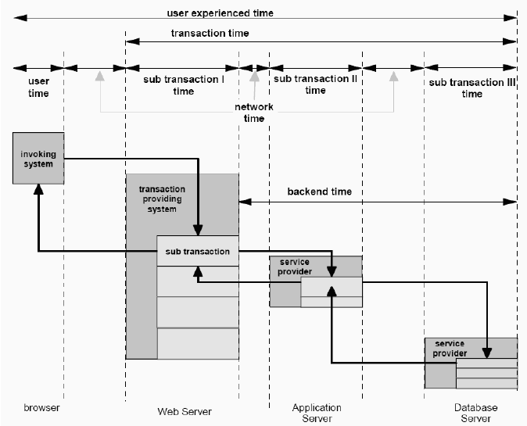
Transaction Breakdown

Slide 5
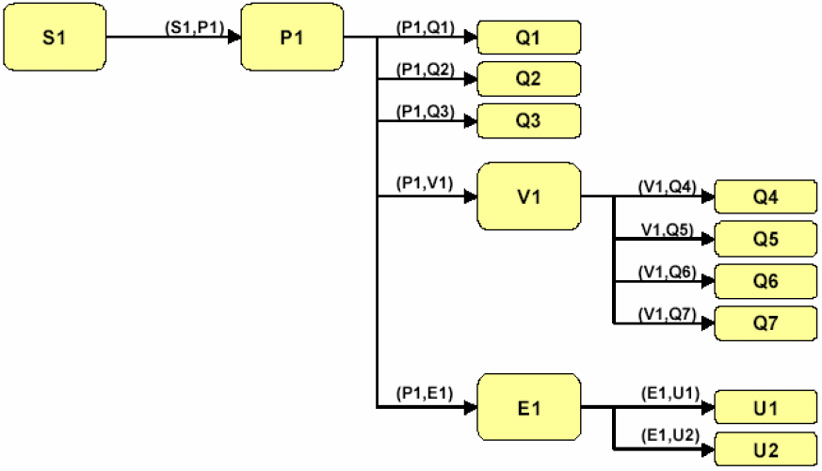
Correlating ARM transactions with their sub-transactions

Slide 6
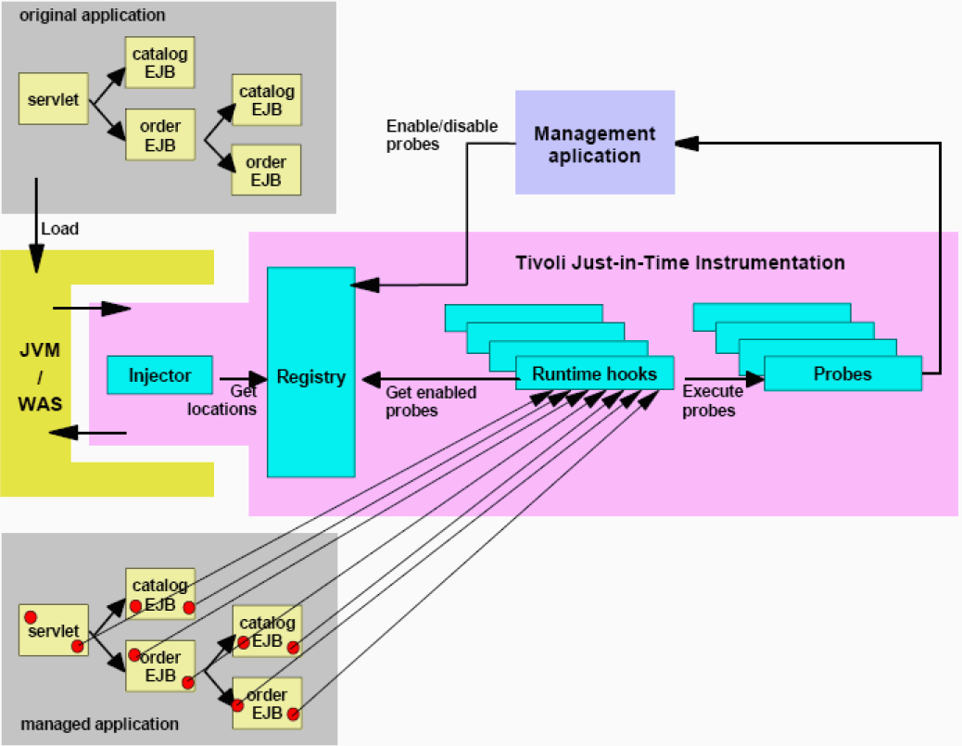
Tivoli Just-in-Time Instrumentation Overview

Slide 7
Application Monitoring
Part 1: Configuring the environment

Slide 8
IBM WebSphere Application Server v6.x
server.xml and variables.xml
{WAS_PROFILE_HOME}/config/cells/{cell_name}/nodes/{node_name}/servers/{server_name}
prirm.xml
Performance Monitoring Infrastructure Request Metrics
{WAS_PROFILE_HOME}/config/cells/{cell_name}

Slide 9
Application Monitoring
Part 2: Enabling Real-time Monitoring

Slide 10
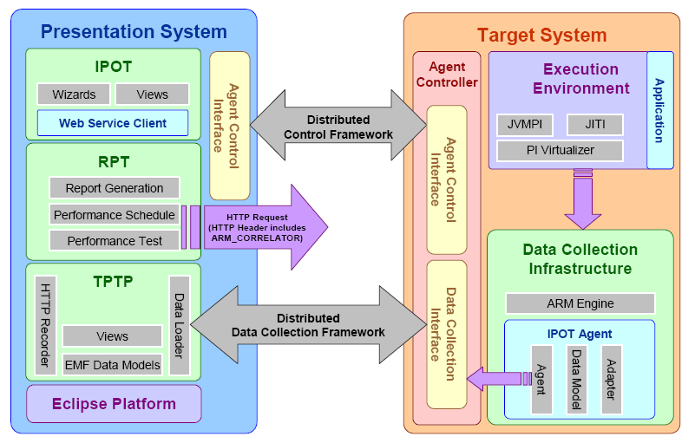
System Architecture using the Data Collection Infrastructure
5
1
ARM-instrumented application (e.g., PlantsByWebSphere)
2
4C
3
4A
Events
4B
Events Transformed by DM

Slide 11
Execution Environment
Just-in-Time Instrumentation (JITI)
The IBM Tivoli J2EE monitoring component
JVM
API called the JVM Profiling Interface (JVMPI)

Slide 12
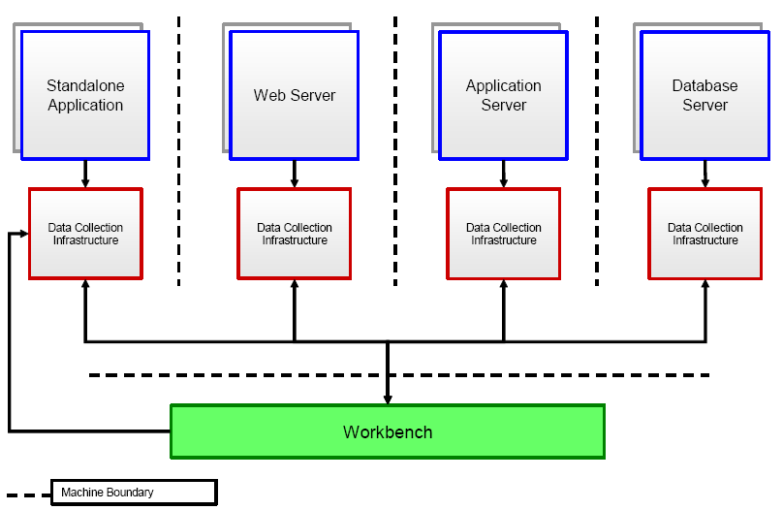
Data Collection Infrastructure for a Distributed Environment

Slide 13
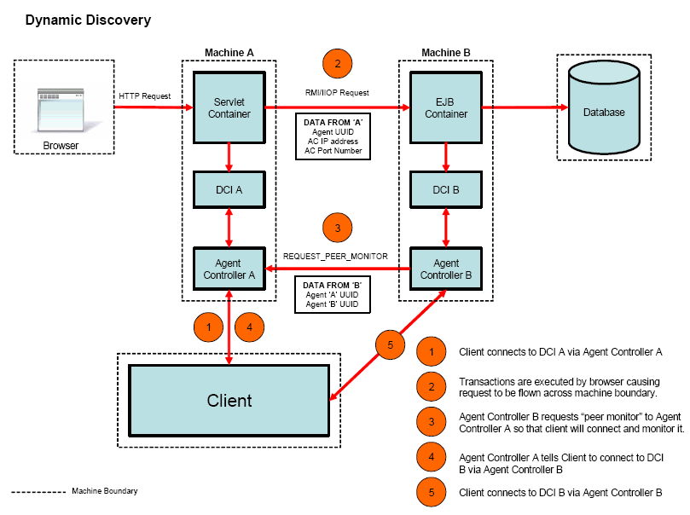
Dynamic Discovery Process

Slide 14
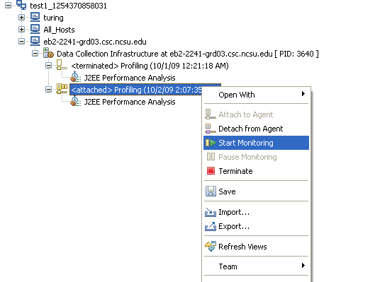
Profiling Monitor for J2EE Performance Analysis

Slide 15
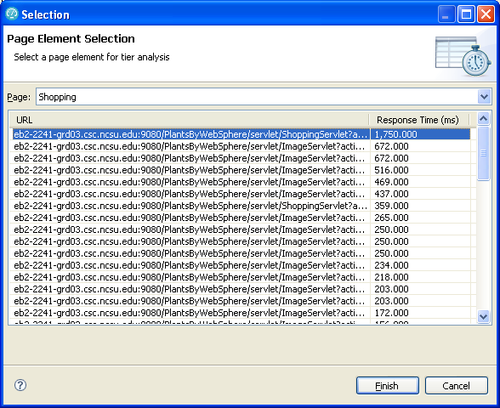
Page Element Statistics Wizard

Slide 16
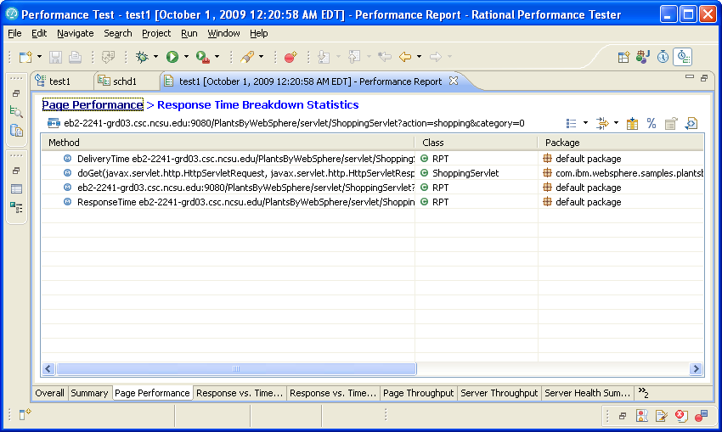
Response Time Breakdown Statistics view

Slide 17
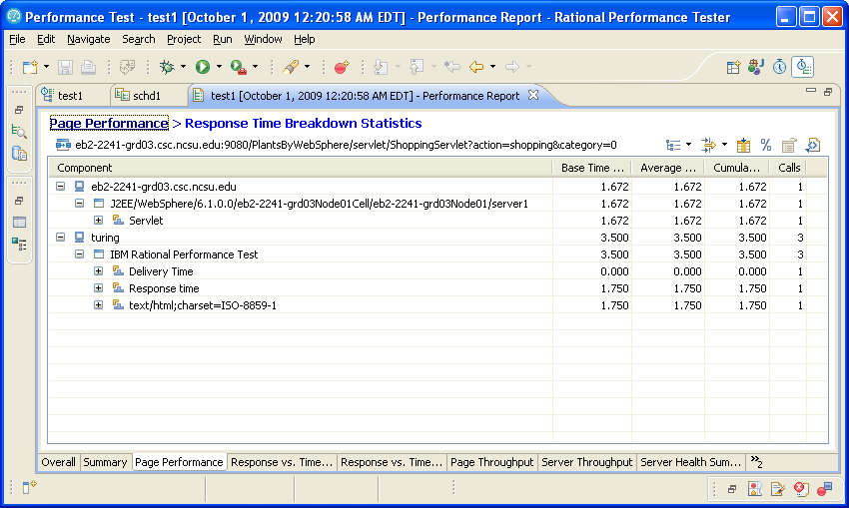
Response Time Breakdown Statistics: Tree layout

Slide 18
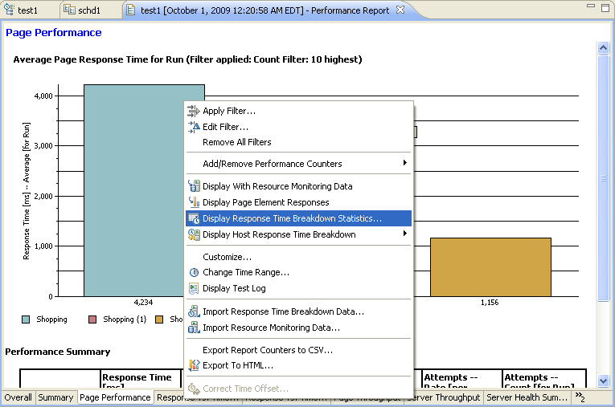
Sample of a Page Performance report

Slide 19
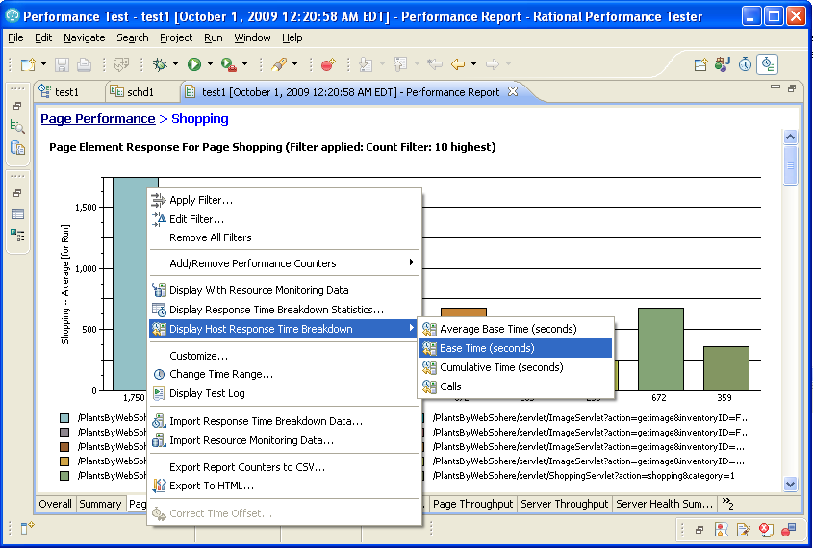
Graphical drill-down reports for Response Time Breakdown

Slide 20
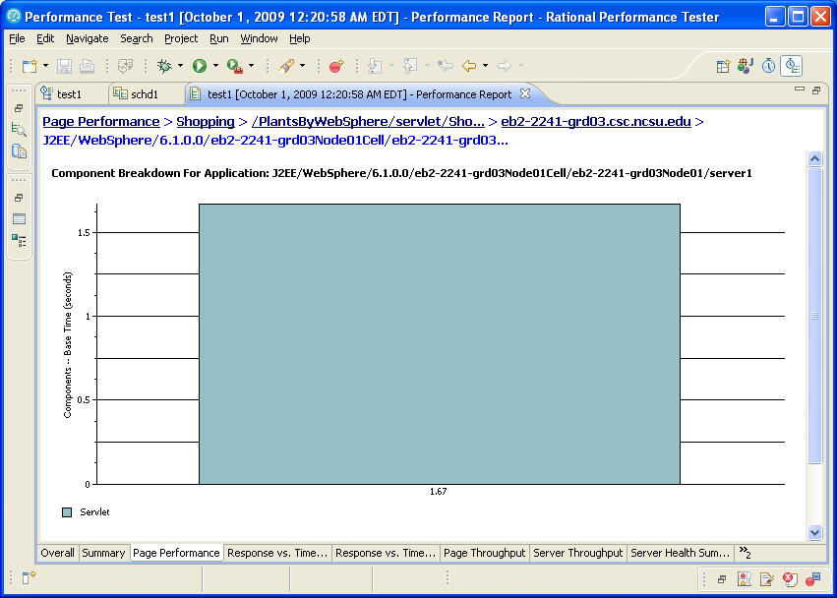
Component Level Drill-down Report

Slide 21
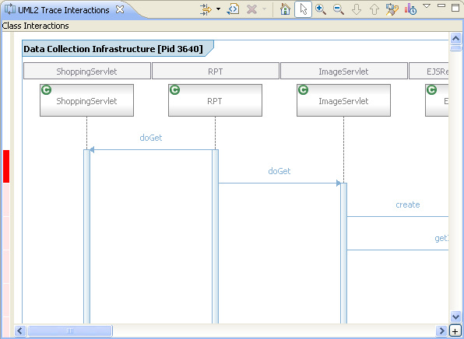
UML Sequence Diagram view

Slide 22
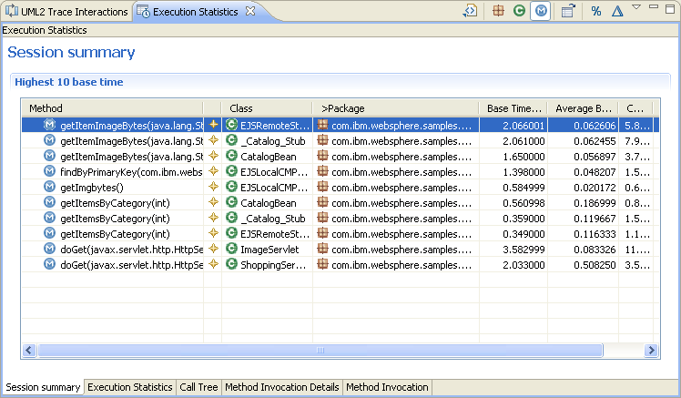
Execution Statistics view

Slide 23
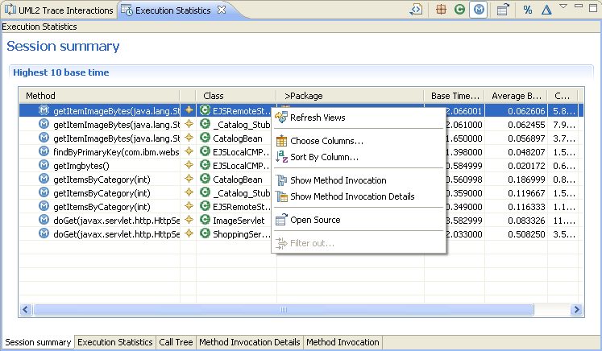
Execution Statistics view right-click context menu

Slide 24
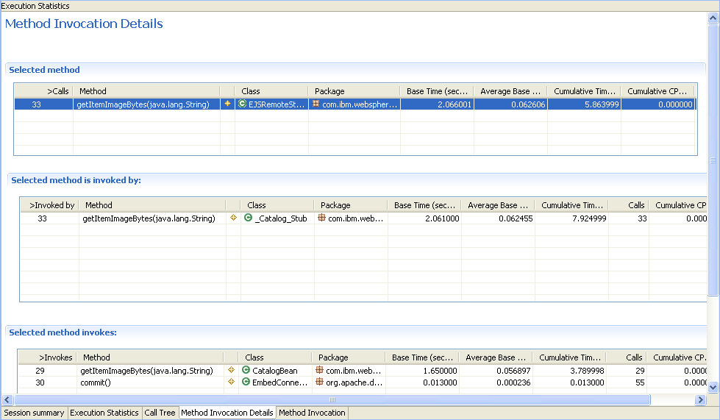
Method Invocation Details View

Slide 25
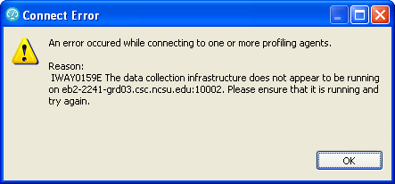
Trouble Shooting
IWAY0159E (http://publib.boulder.ibm.com/infocenter/rpthelp/v7r0m0/index.jsp?topic=/com.ibm.rational.test.lt.doc/topics/uiway0159e.html)

Slide 26
Application Monitoring
Par 3: Importing data from IBM Tivoli database products

Slide 27
References
Install WebSphere Application Server V6.0 for Linux on POWER (http://www.ibm.com/developerworks/systems/library/es-webapp/index.html)
WebSphere Application Server 6.1 Headless Install (http://bishop.camp.clarkson.edu/wiki/en/WebSphere_Application_Server_6.1_Headless_Install)

Slide 28
References
Using IBM Rational Performance Tester: Application Monitoring Part 1, Configuring your environment (http://www.ibm.com/developerworks/rational/library/07/0515_patel/index.html)
Using IBM Rational Performance Tester: Application Monitoring Part 2, Enabling real-time monitoring (http://www.ibm.com/developerworks/rational/library/07/0515_patel2/index.html)
Using IBM Rational Performance Tester: Application monitoring, Part 3: Importing data from IBM Tivoli database products (http://www.ibm.com/developerworks/rational/library/07/0605_patel/index.html)

